Slide 1
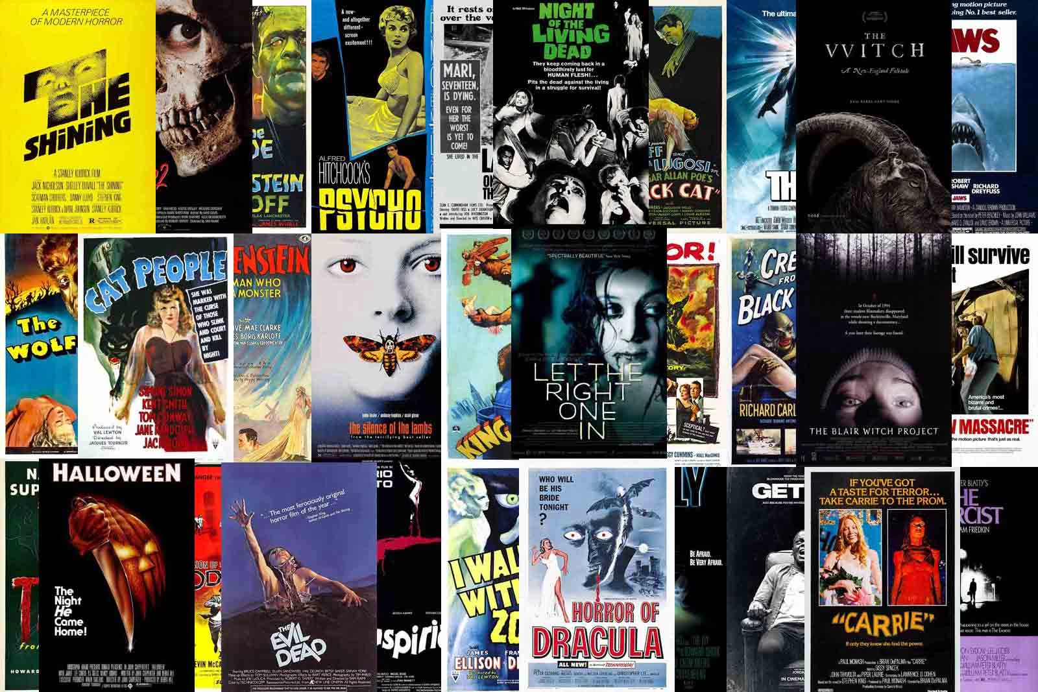
Movies, Movies, Movies, Movies
By Ben Sarsfield

Slide 2

Setting the Scene
Overview | Data | Exploration

Slide 3
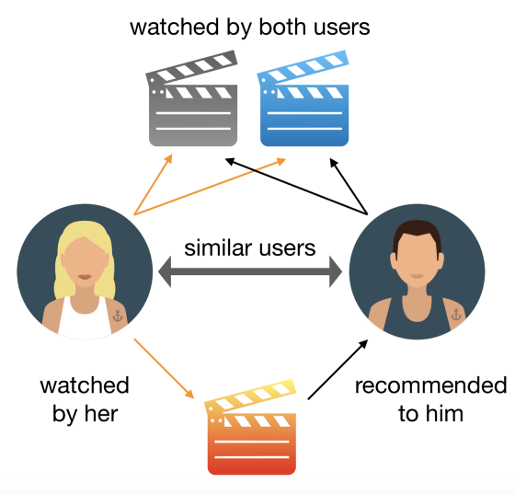
Recommendation Systems
Recommendation systems are hugely important in the entertainment industry. They can:
Reduce churn rate
Improve User Satisfaction
Increase customer loyalty
But they are not perfect

Slide 4
Project Overview
We have all struggled to find a film to watch
Recommendations on streaming platforms are limited
The goal was to create a movie recommendation system
User’s input a film title and receives five similar movies
There were a few challenges…

Slide 5
Getting the Data
01
02
03
04
Needed data that was large enough to make accurate recommendations
Had the features that I was interested in
I could legally source
Covered a wide range of genres and themes

Slide 6
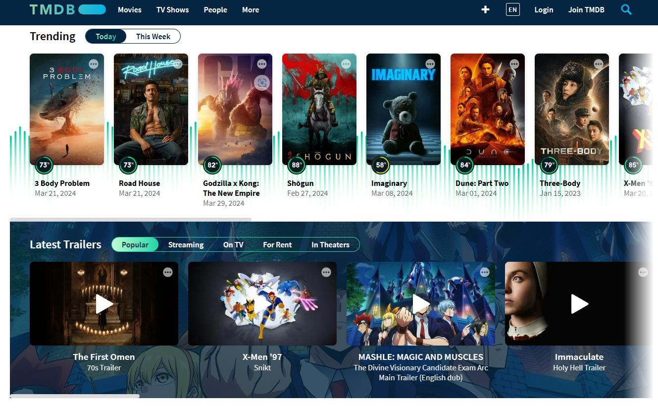
Getting the Data
Dataset met all of the requirements.
It was sampled from TMDB movies
It contained a plethora of features
Had adjacent data frames
It required extensive cleaning and preparation

Slide 7
Data prep
Joining data frames
Dictionary values
Zeros
The dataframes needed to be joined on id’s
Many columns had dictionary inputs
Some features contained mostly 0’s including key columns such as revenue/budget

Slide 8
Data prep
Joining data frames
Dictionary values
Zeros
Only joining key features to the overall data frame
Converting to list -> OHE
Avoid using these columns in the clustering process

Slide 9
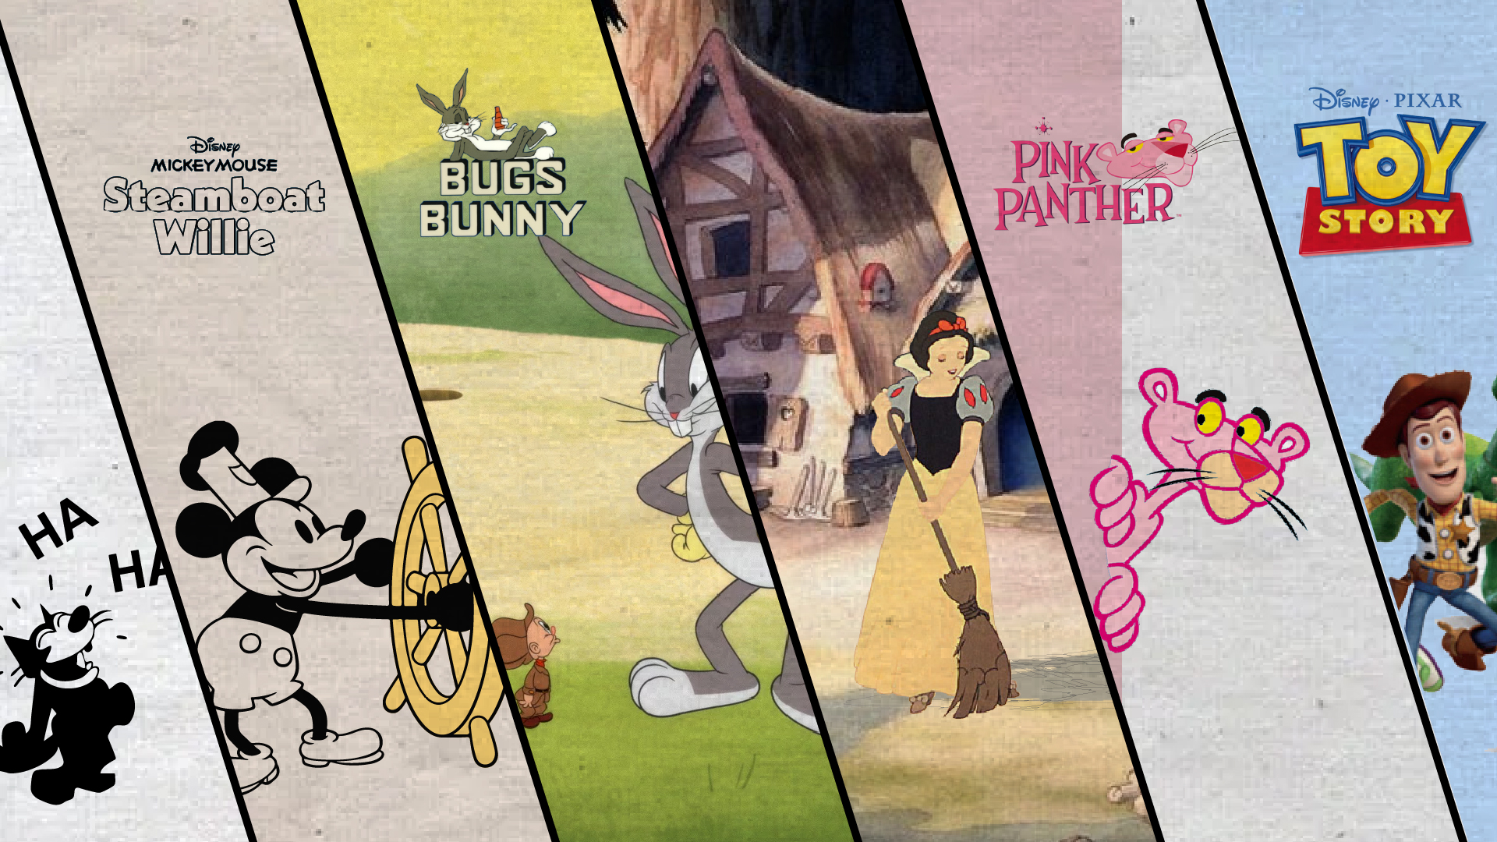
The Evolution of Movies

Slide 10
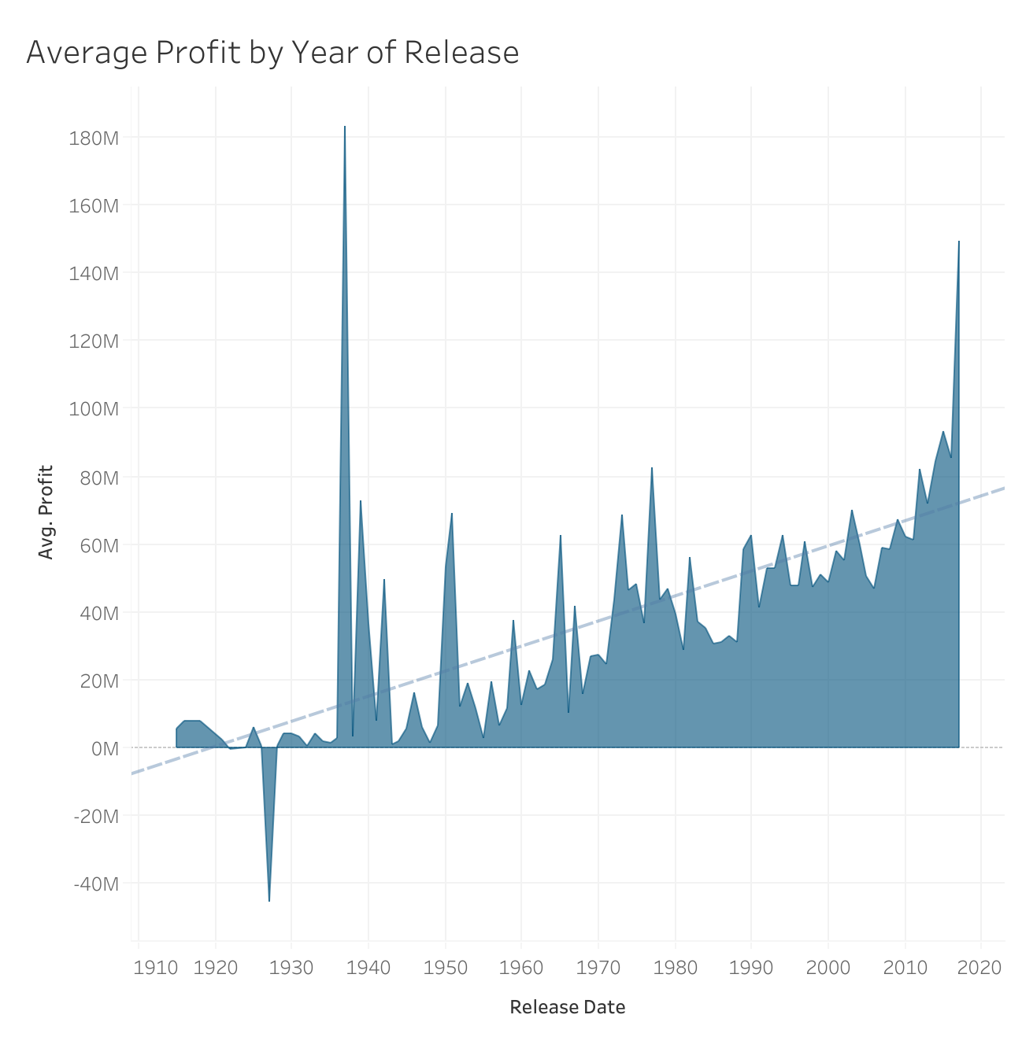
How does profit vary over the years…
Only two years that don’t appear to be profitable over the data: 1922 and 1927
Recorded a loss of around 46 million in 1927
Overall upwards trend
There is a peak in 1937 with a recorded average profit of 183 million

Slide 11
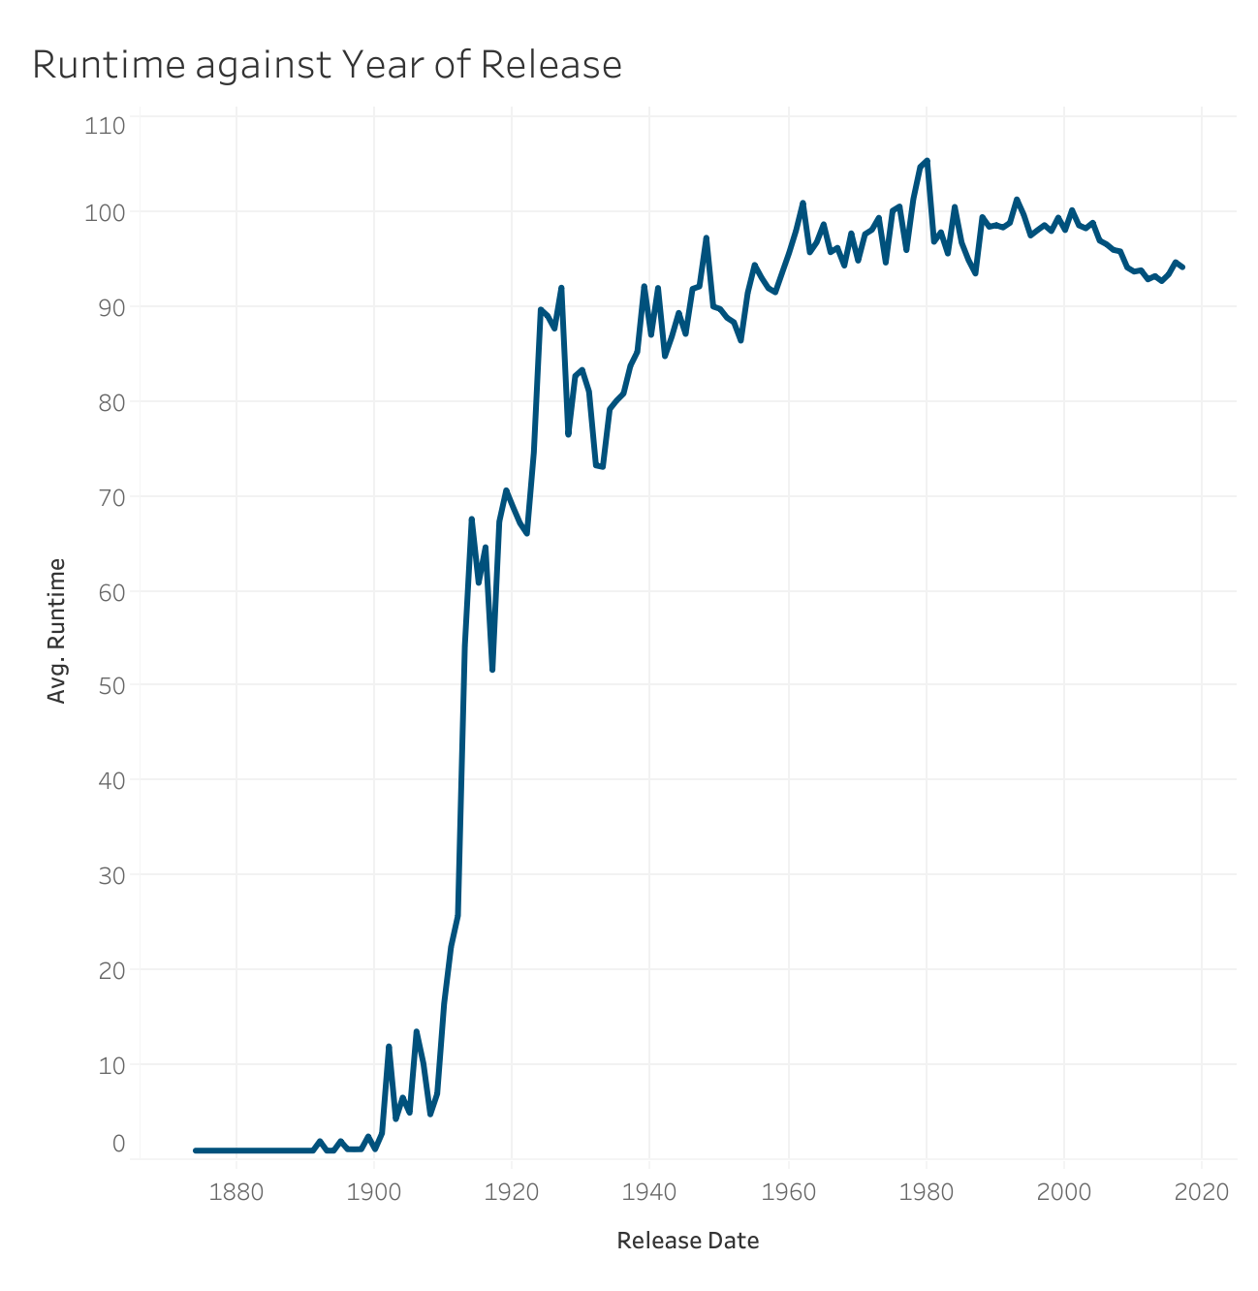
Films are getting longer…
Movies are getting longer in length
Jump from 1909 to 1914 where the average runtime increased by an hour
Between 1901 to 1902 there is a comparatively large jump from 2.8 to 12 minutes in length

Slide 12
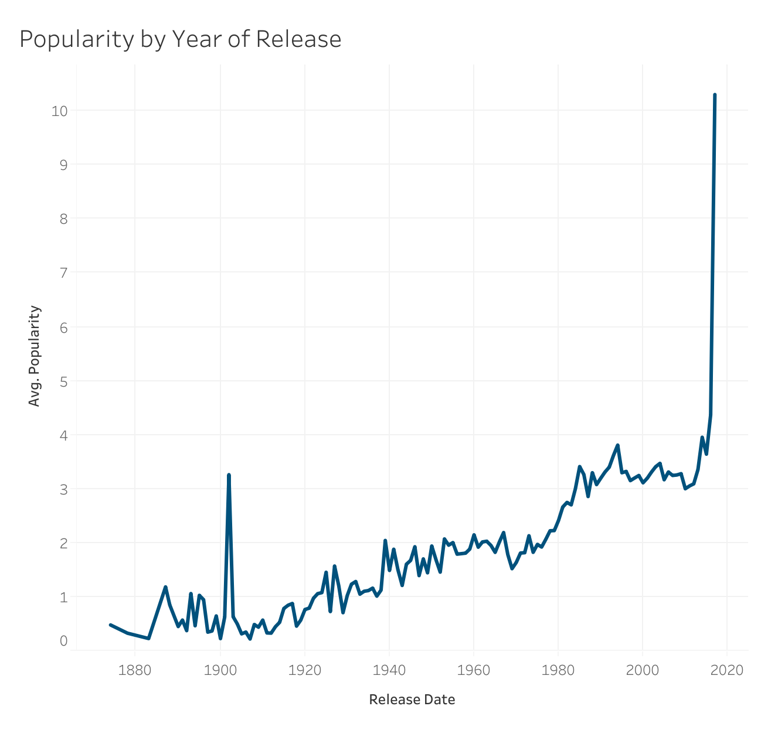
The growing popularity of movies
Popularity is a metric used by TMDB:
- The total number of votes a film has
- Daily views and votes etc.
General upward trend
Large increase between 2016 and 2017
Average film popularity over doubles

Slide 13
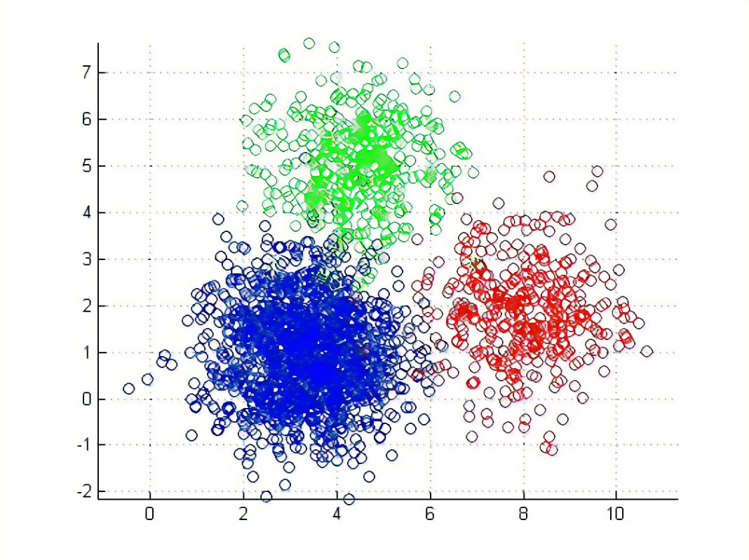
Constructing the system
Feature Selection | Clustering | Building the Function

Slide 14
Clustering
01
02
03
Unsupervised learning
Dividing unlabelled data
Similar data points lie in the same cluster

Slide 15
K-means Clustering
K-means is an iterative clustering algorithm. It works in five steps:
Specifying the number of clusters
Randomly assign each data point to a cluster
Compute cluster centroids
Re-assign each data point to the closest cluster centroid
Re-compute cluster centroids
Then repeat steps 4 and 5 until no improvements can be made
Source: Clustering in Machine Learning: Different Methods and Applications (analyticsvidhya.com)

Slide 16
Large amount of data -> K-means

Slide 17
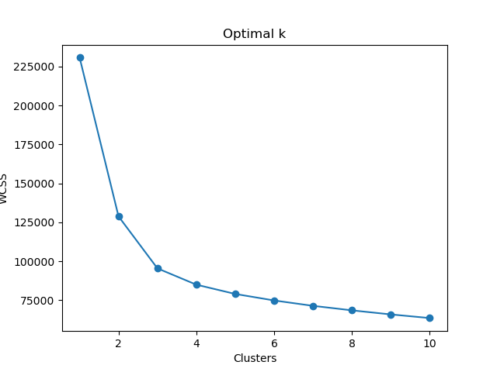
Finding the optimal number of clusters
I needed to find the optimal number of clusters to segment my data
I used a for loop to calculate the WCSS values for k-clusters between 1 and 11
Produced a Scree Plot
I found that the I should use 4 clusters.

Slide 18
Feature Selection
Deciding the best features to use was difficult
I used the Silhouette score as a metric to compare my feature selections
Trial and error
My final product consisted of all of my genre columns as well as the average rating
Silhouette score of 0.19

Slide 19
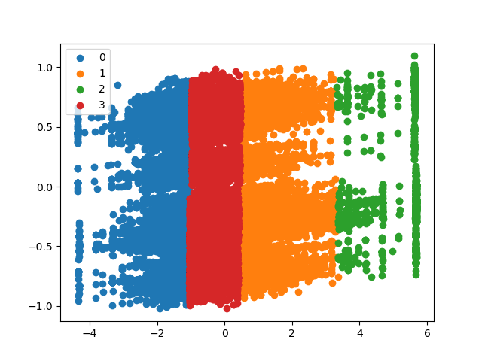
Visualising the clusters
Visualisation required PCA
Fit my data into a 2D space
This led me to plot
There were some class imbalances

Slide 20
Building the function
Designed a function that:
Takes a movie title as a user input
Outputs five movies that are similar to the input
Uses the Euclidean distance between data points
Those that are closest are outputted

Slide 21
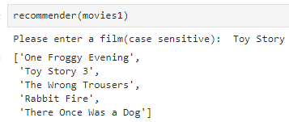
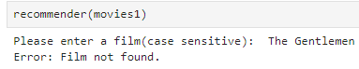
The function
The function is case-sensitive
Outputs an error message if the movie of choice is not within the dataset
Outputs a top 5 list of most similar films

Slide 22
Project limitations
01
02
03
04
The dataset only had 45,000 films
Low Silhouette score
Recommendations limited to years before 2017
Few features used

Slide 23
Project improvements
01
02
03
04
More records -> More Accurate results
Improve the UI
Gather more recent data
Include TV shows

Slide 24
Summary
I achieved my objective of creating a movie recommendation system through clustering algorithms and very extensive cleaning.
There are areas to build on in the future

Slide 25
Thank you for listening
“ Movie recommendations are my favourite thing”
~ Alex Caian

